Slide 1

Copper Alloy Discovery using Machine Learning
Supervised by Prof. Nick Birbilis
COMP4560 - Advanced Computing Project
Presentation by Abhinav Pandey

Slide 2
Outline
Introduction
ML Model Selection
For Tensile Strength Prediction
For Thermal Conductivity Prediction
Smart Alloy Generation System (SAGS)
Results
Limitations and Future Work
Alloy Generation Demo

Slide 3
Introduction
Copper alloys
Very versatile
Can have properties like high tensile strength, thermal conductivity
More than 500 alloys already exist
Motivation for the project?
Conventional development of new alloys –
depends on Expert judgement
depends on Trial and Error
Is time consuming and expensive
There is a need for a reliable “property-based” alloy composition recommendation system.

Slide 4
The Smart Alloy Generation System
Takes user input :
Alloy property (Tensile Strength or Thermal Conductivity)
Magnitude of selected property
Returns :
Alloy compositions
Processing Conditions (for tensile strength based alloy recommendations)
How? Using Machine Learning!

Slide 5
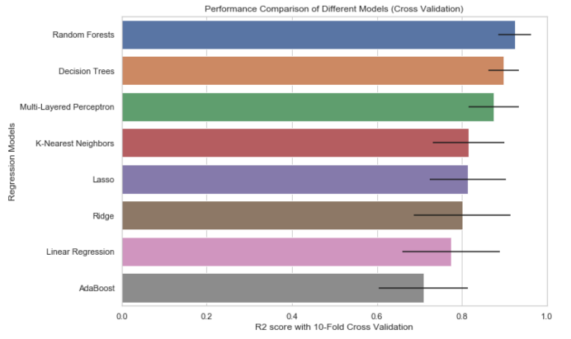
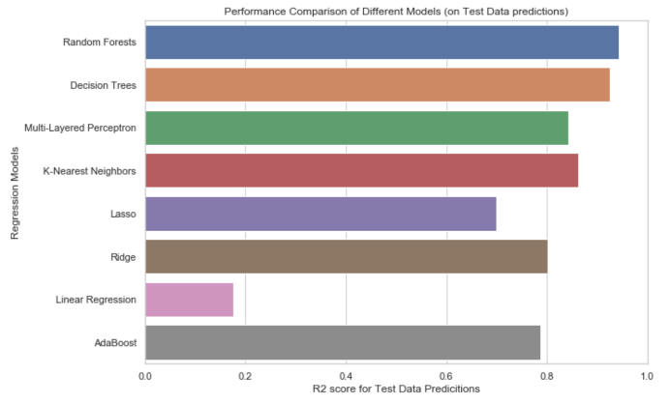
Tensile Strength prediction model

Slide 6
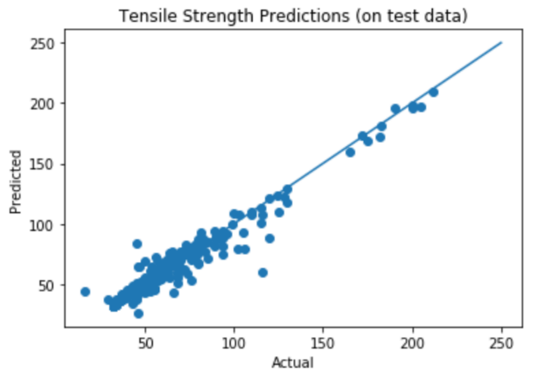
Prediction Quality (Tensile Strength)
10-Fold Cross-Validation Performance = 92.55 %
Accuracy on Unseen Data = 93.85%

Slide 7
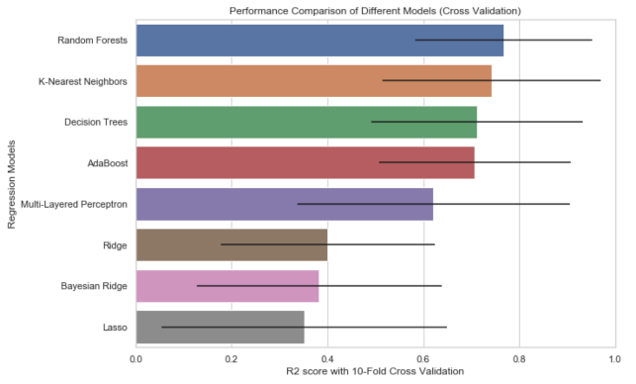
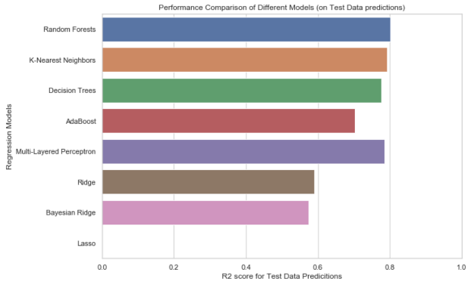
Thermal Conductivity prediction model

Slide 8
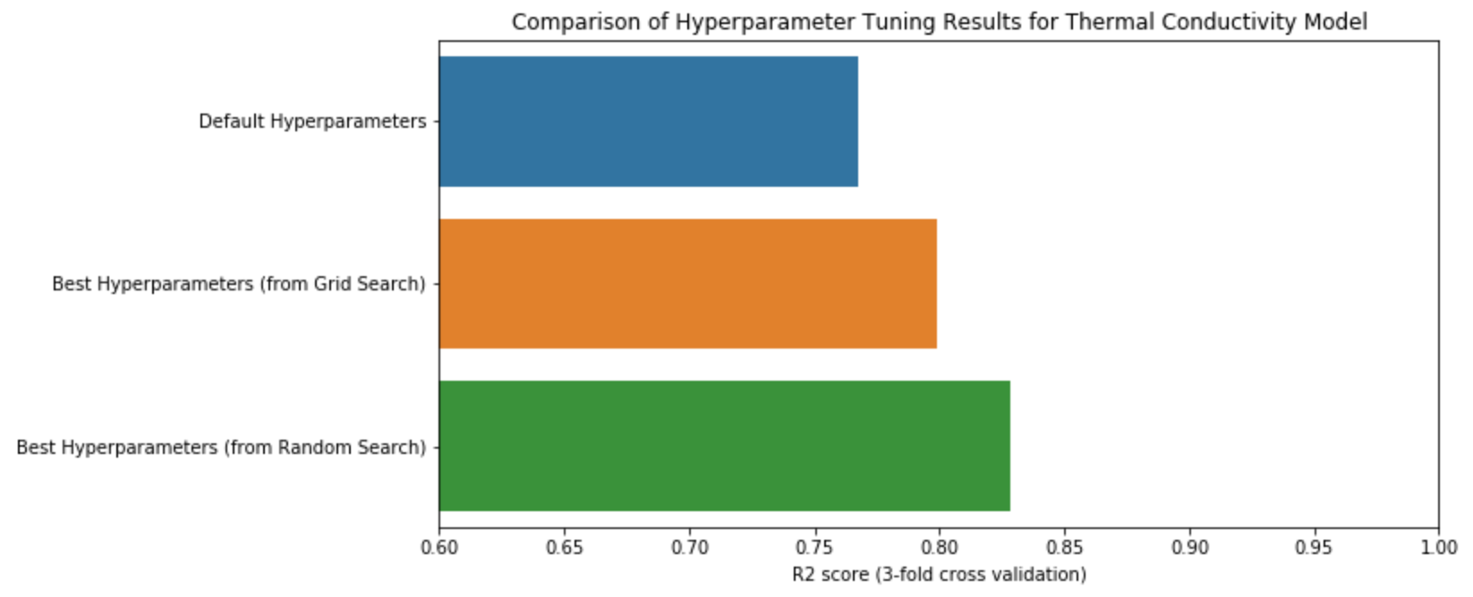
Hyperparameter Optimization

Slide 9
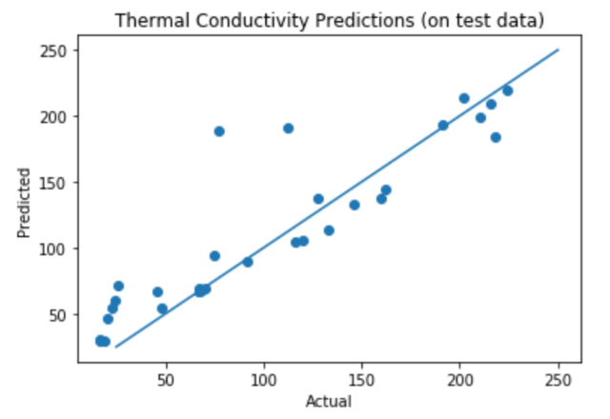
Prediction Quality (Thermal Conductivity)
10-Fold Cross-Validation Performance = 82.26 %
Accuracy on Unseen Data = 83.17%

Slide 10
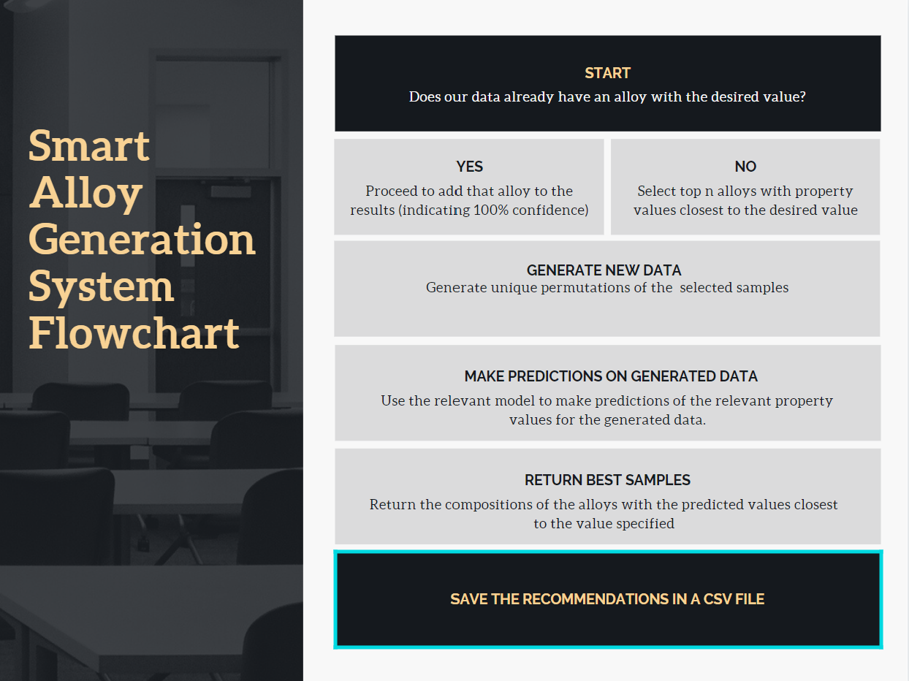

Slide 11

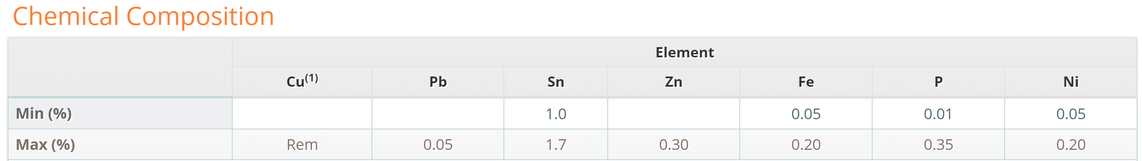
Example of Promising Result
Confidence % | Form | Temper | Cu | Pb | Zn | Fe | P | Ni | Sn
100 | wire | Precipitation Heat Treated or Spinodal Heat Treated and 1/2 Hard | 97.55 | 0.6 | 0.05 | 0.05 | 0.2 | 1.5 | 0.05
100 | strip | Extra Hard | 88.5 | 0.05 | 10.96 | 0.03 | 0.06 | 0.8 | 0.7
92.5 | products | Extra Hard | 97.377 | 0.054 | 0.311 | 0.132 | 0.215 | 0.159 | 1.751
92.5 | products | Extra Hard | 96.594 | 0.051 | 0.051 | 0.051 | 0.203 | 1.017 | 2.034
Inputs:
Property = Tensile Strength
Property Magnitude = 78.5
Tensile Strength of Recommended alloy = 80

Slide 12
Limitations
The system is most reliable when the specified value lies in the range of the training data values, for both physical properties.
For instance, if we search for alloy compositions with tensile strength = 250 ksi, then the recommended alloys have an actual value of only 212 ksi.
The recommended alloys can only have the elements which are present in the training data. Since, the training data does not contain alloys with Carbon (which have shown to result in high tensile strength alloys), the recommendations do not have Carbon based alloys.
Due to the small size of the dataset for thermal conductivity it is hard to say if the datapoints are a good representative sample of all copper alloys (More alloy data needs to be added)

Slide 13

Questions?

